Slide 1
Recent sold house in San jose, from Realtor.com
Web scraping

Slide 2
Objective
Analysis recent house marketing in the San Jose
Find what factor determine the house price
Which area or structure are popular and worth investment
Provide suggestions for new buyer

Slide 3
Data rescource
Most recently three months sold house data from Realtor.com
Only in San Jose area
Using web scraping to download the data

Slide 4
Web Scraping
Web scraping in Python
Inspect page and get data from HTML message
Get the link for each sold house and investigate it to scrappy detail data.
Data size: 687 houses due to website block
Time: 10 mins

Slide 5
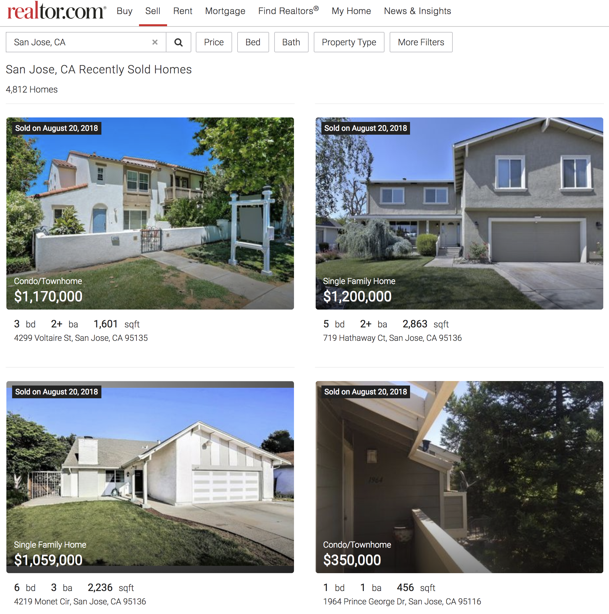
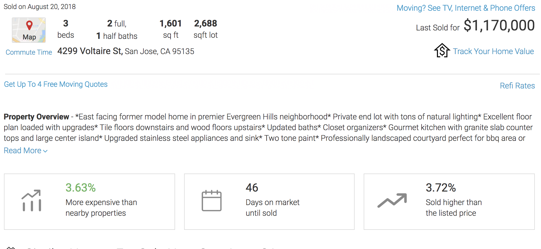
Data Description
Address , city, state, zip_code
Beds, bath_full, bath_half
Area_ft, lot_ft
Sold_price, sold_date, price_ft
Property_type, built_year
School Rate
Days_on_market

Slide 6
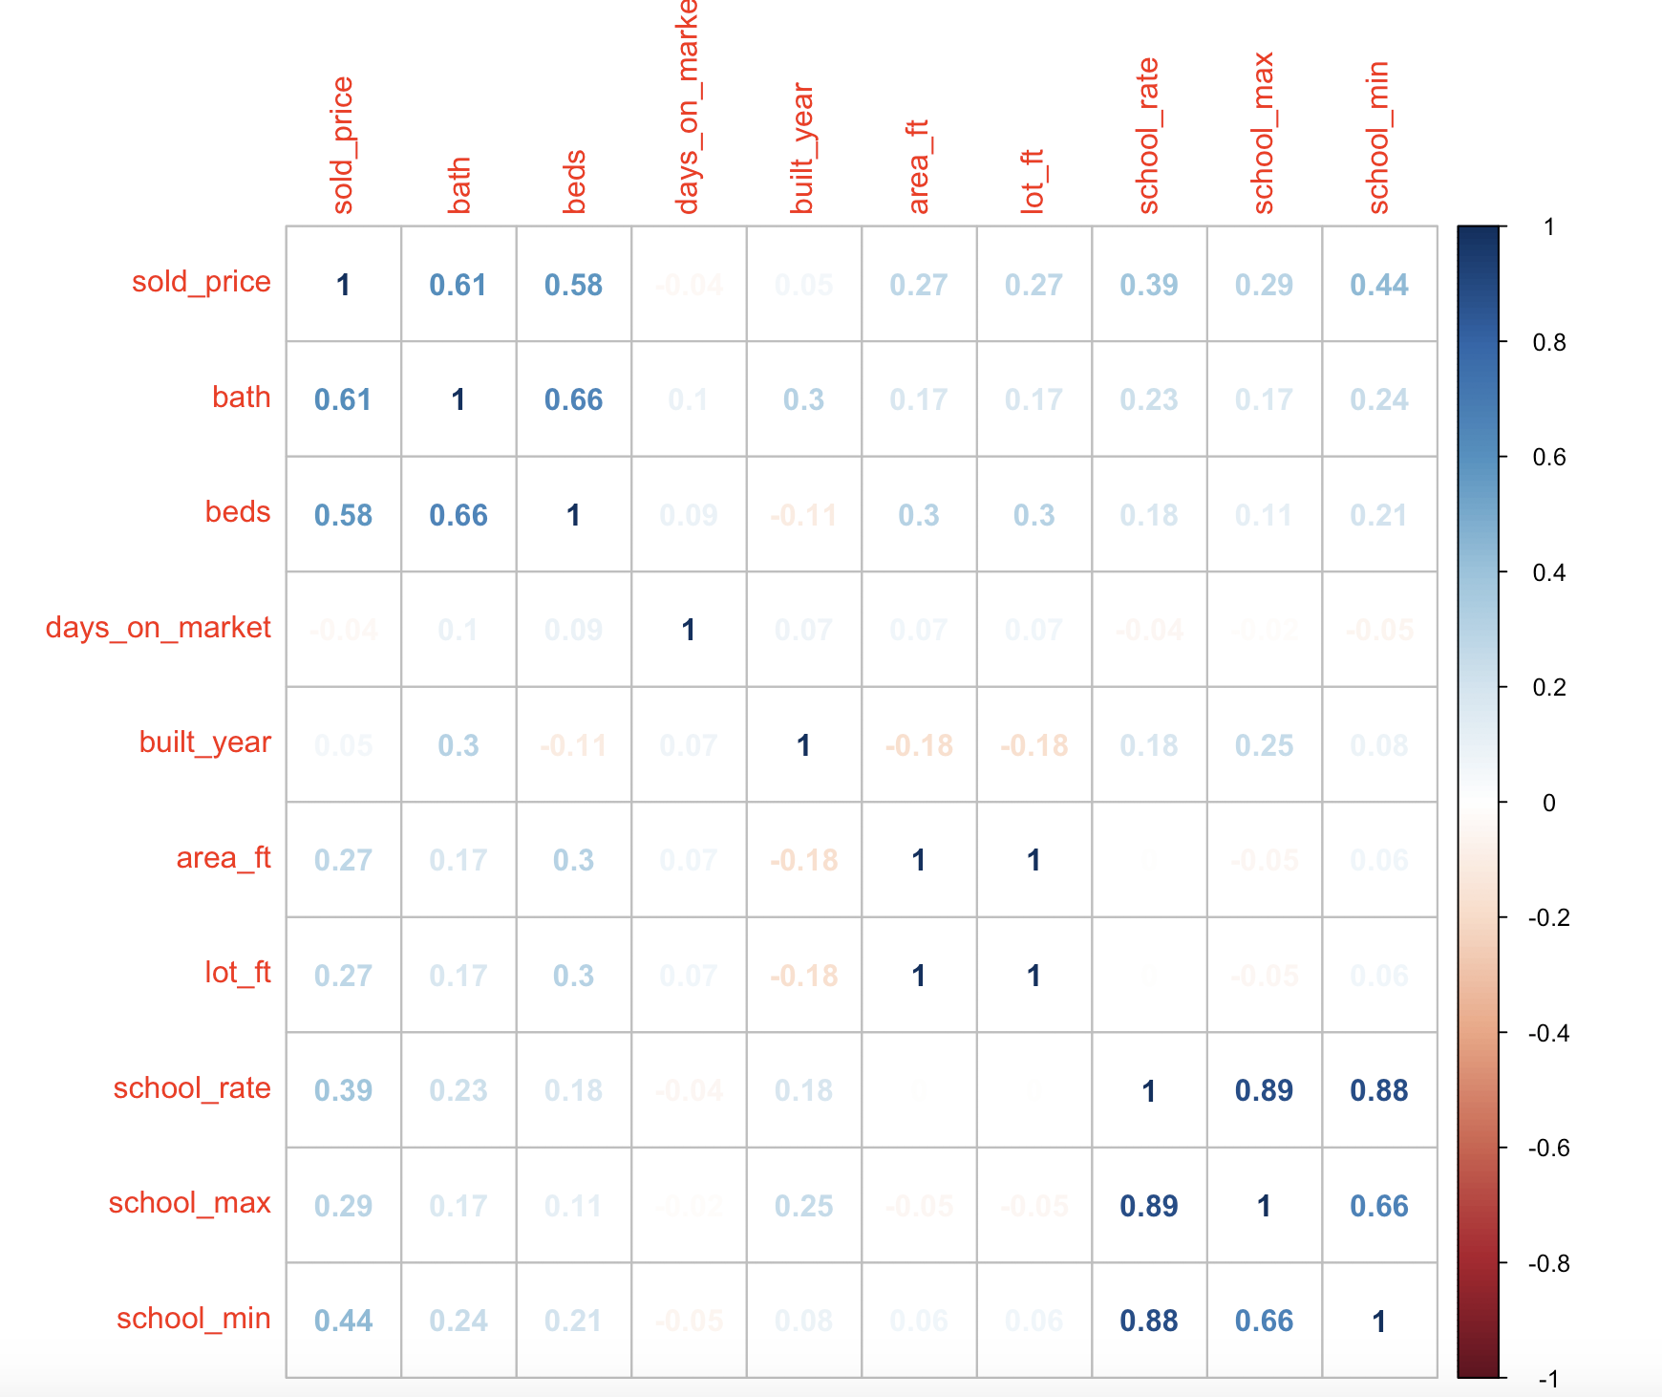
Data analysis --correlation
Bath, beds number and lowest school rate affect the sold price most
Recent build house has fewer area and lot ft, tend to has fewer beds and more baths

Slide 7
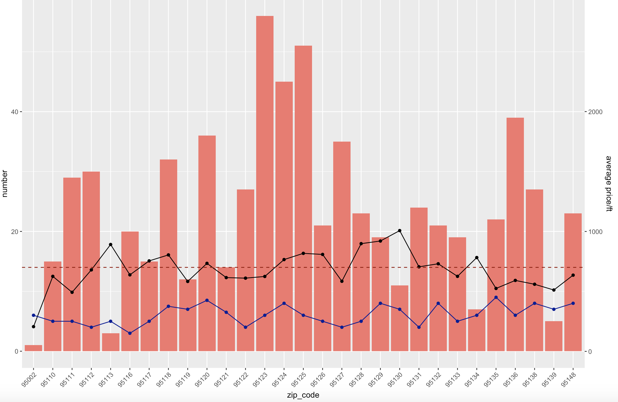
Data analysis – zip code
95130 has highest average price/ft, most expensive area
95123 sells most number of house
Most average price around $700/ft

Slide 8
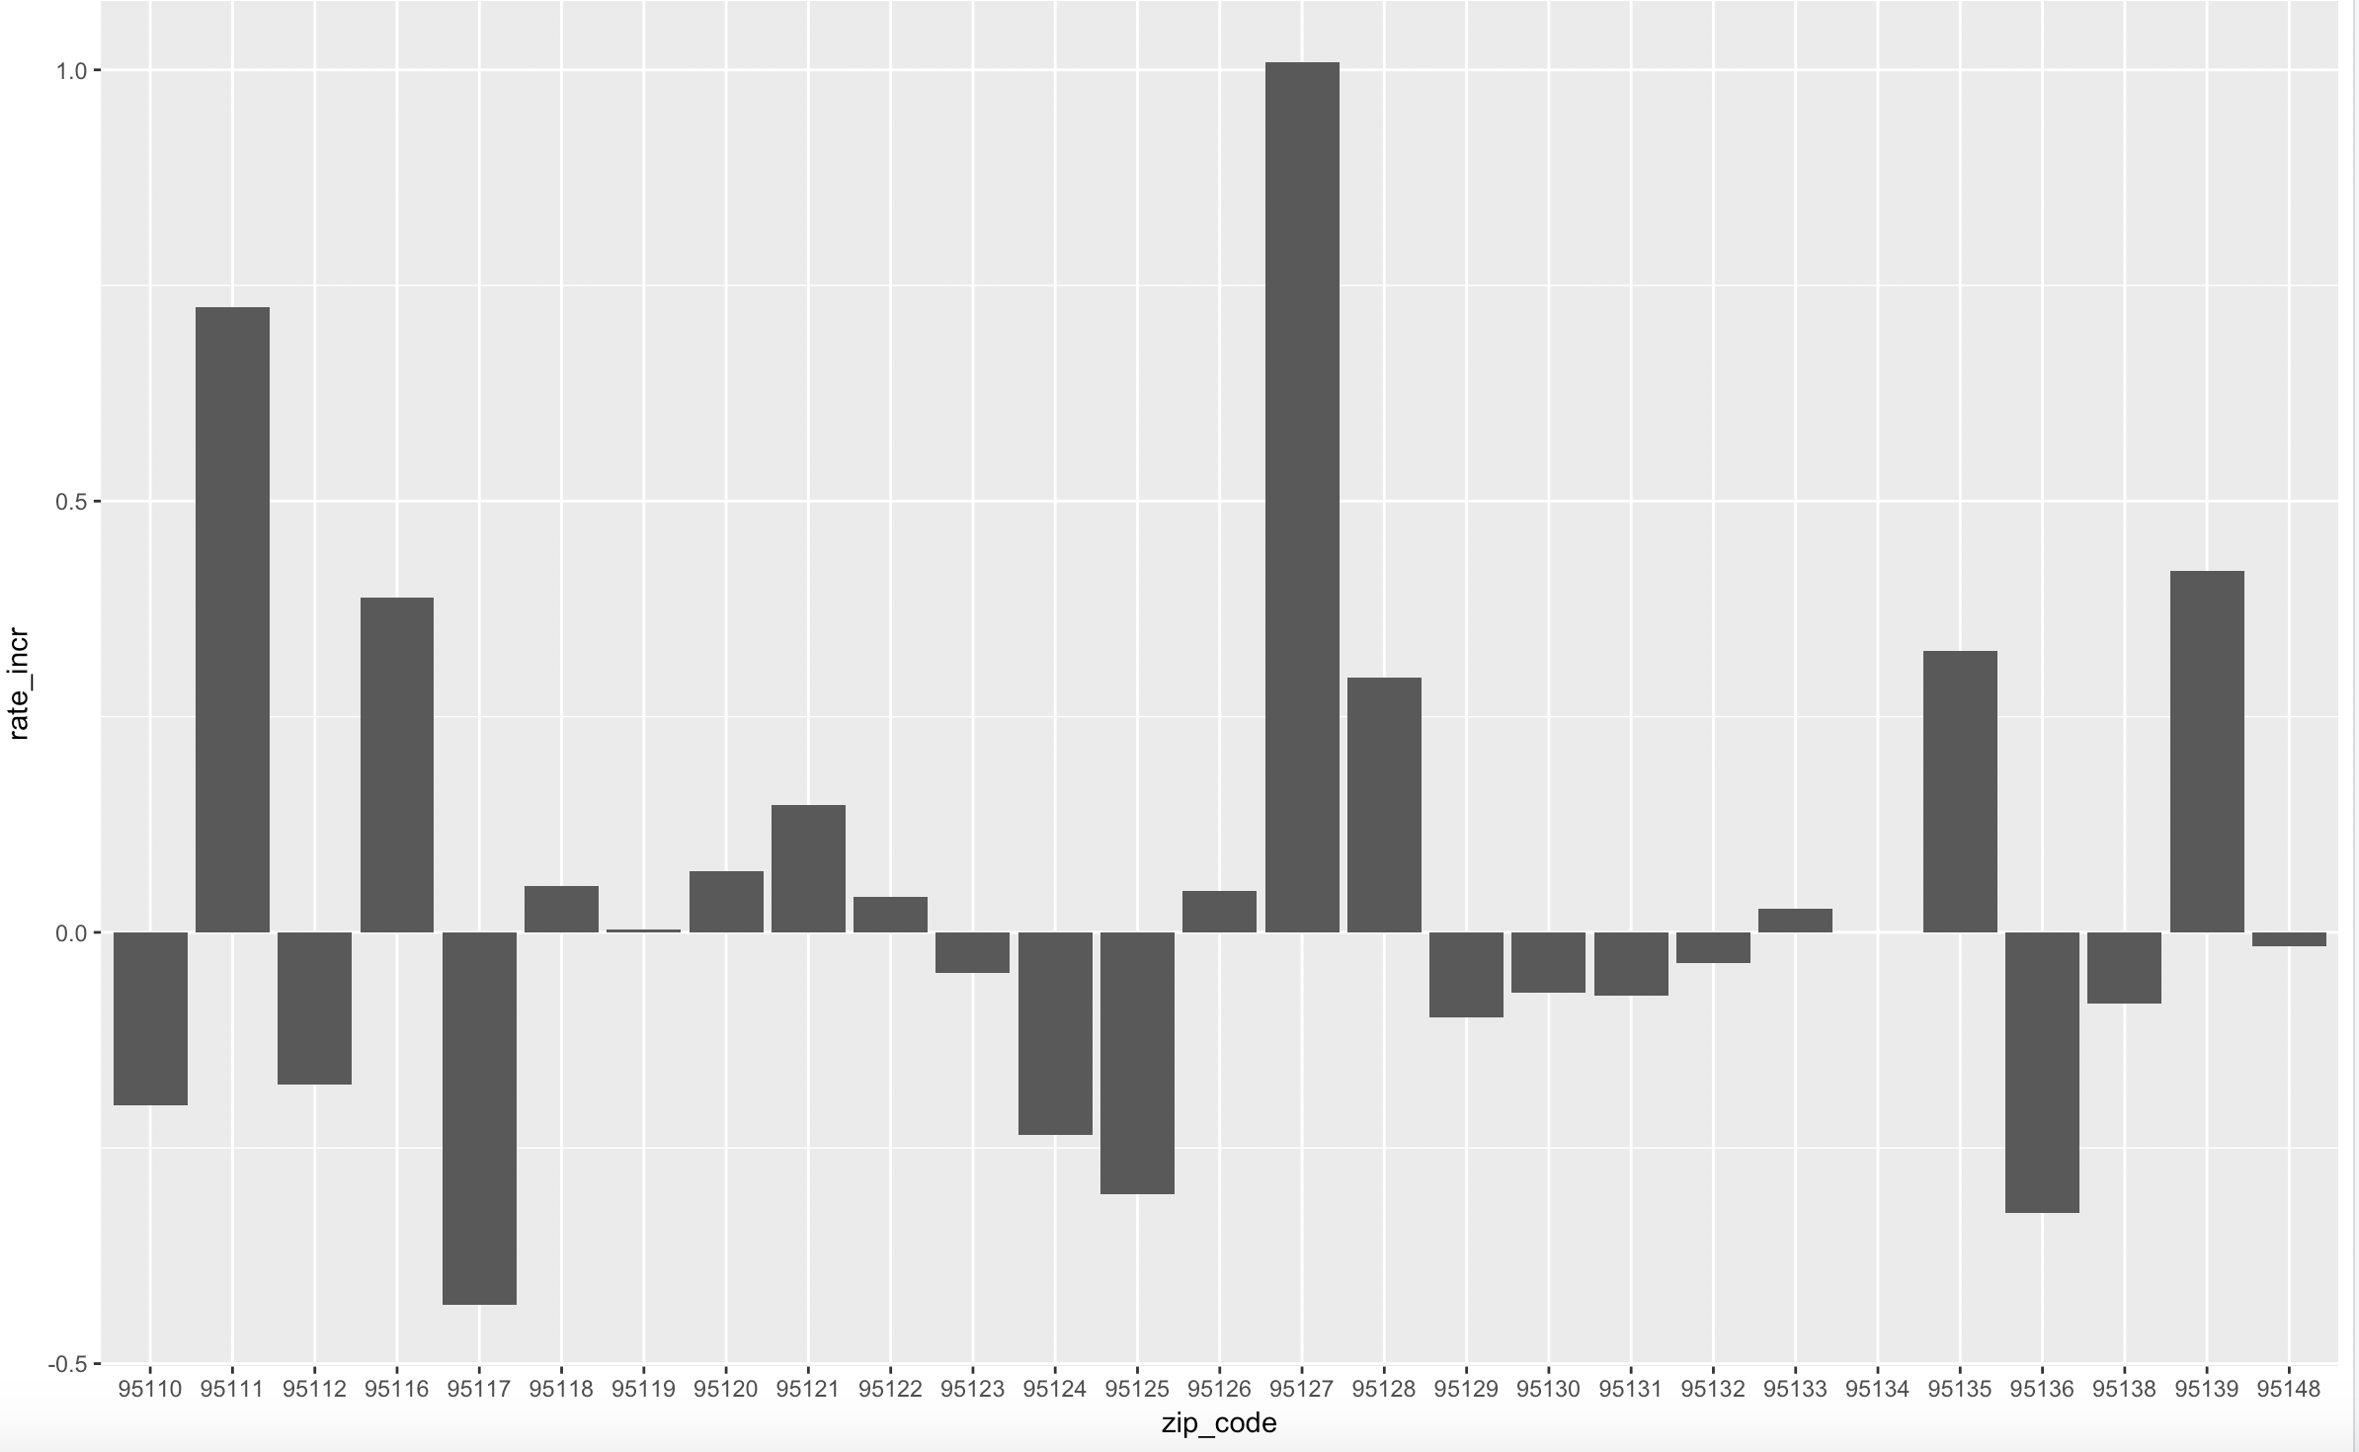
Increasing Rate by Zip code
May be an outlier
Single family house
Recent three month median price/ft increasing rate
95111 has highest increase rate
May have outlier

Slide 9
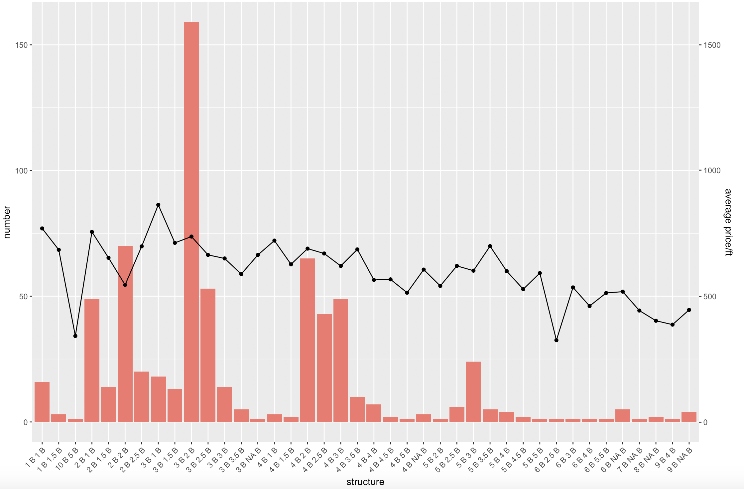
Data Analysis – house structure
3B2B house structure is most popular house type
The average price/ft for each house type is pretty flat
More bedrooms, less price/ft

Slide 10
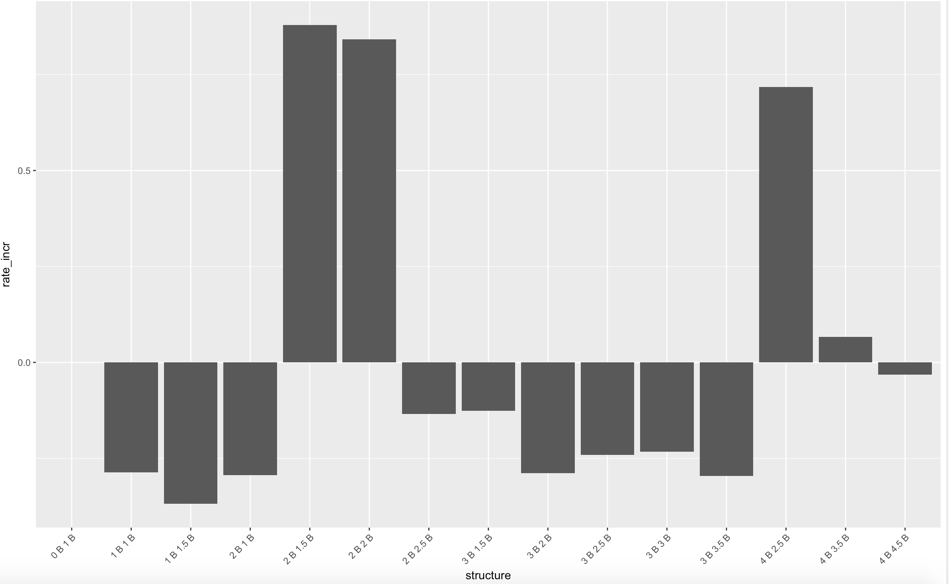
Rate increase by house structure
Condo/Townhome/Row Home/Co-Op
2B/1.5B , 2B2B and 4B/2.5B price/ft increase most
May need to specify to the zip code

Slide 11
Suggestions
School rate, beds and baths number affect house price most
Old houses have more area and better structure
95111 has highest rate increase
3B2B is most popular house structure but 2 bedrooms rate increase more
More data need to import for better analysis

Slide 12
question
Is the data enough?
The data might not enough, but that’s due to the website blocker, and it include all the sold house for last month on the Realtor.com
Why area is not high correlate with price
Because school rate play more import role in house pricing

Slide 13
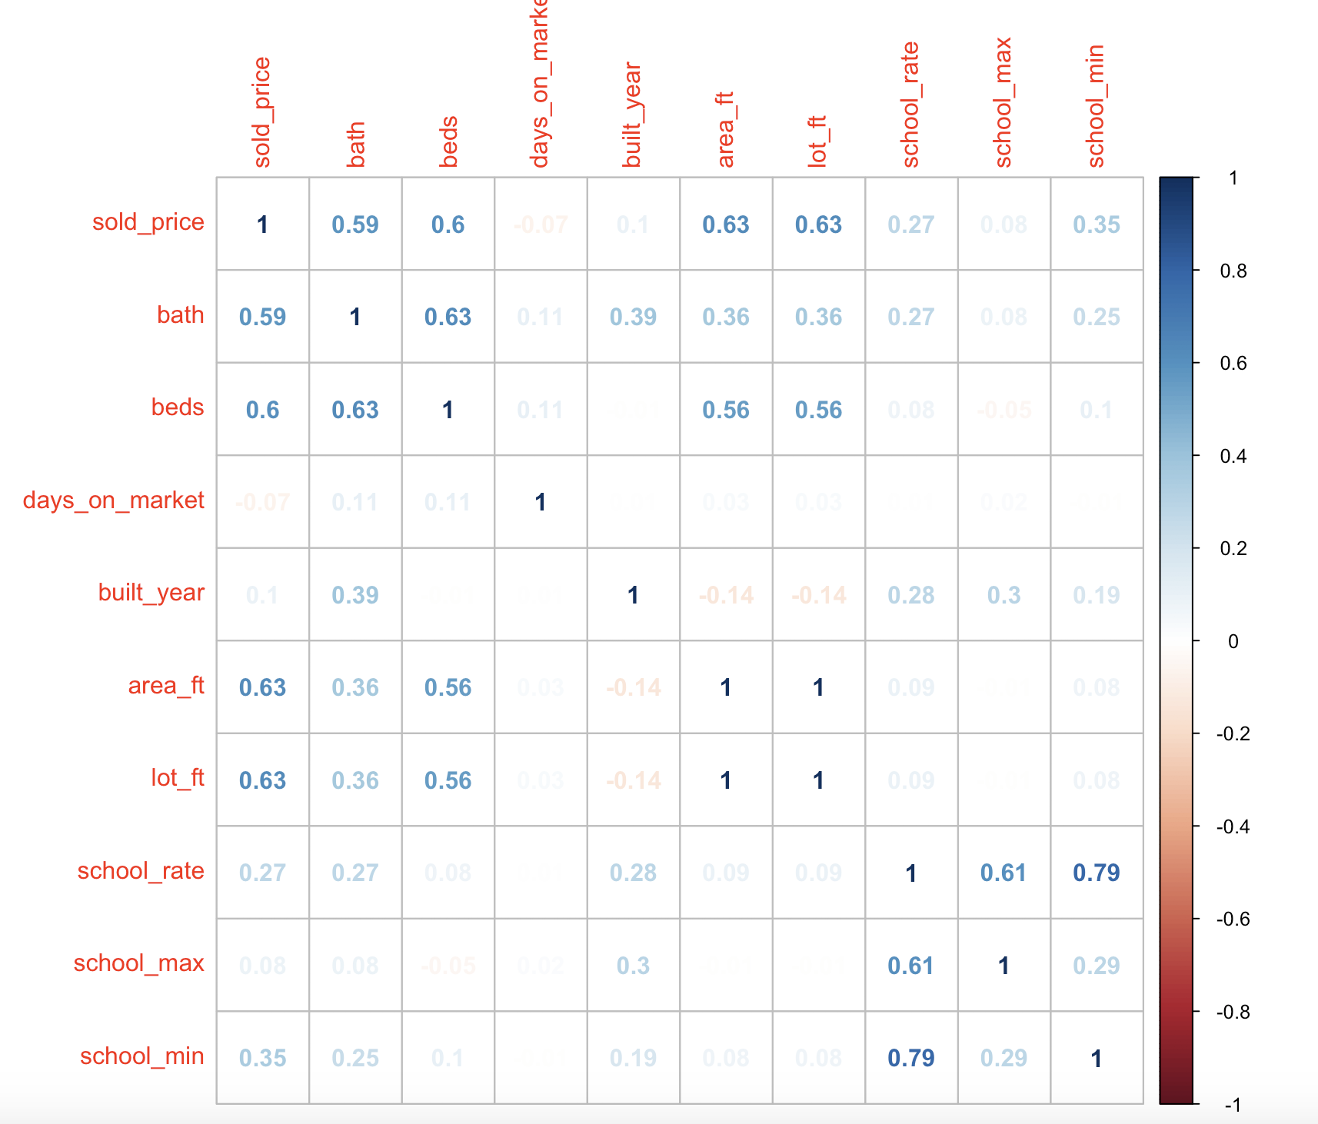
Average school rate>=7,
Area is highly correlate with the price

